Slide 1
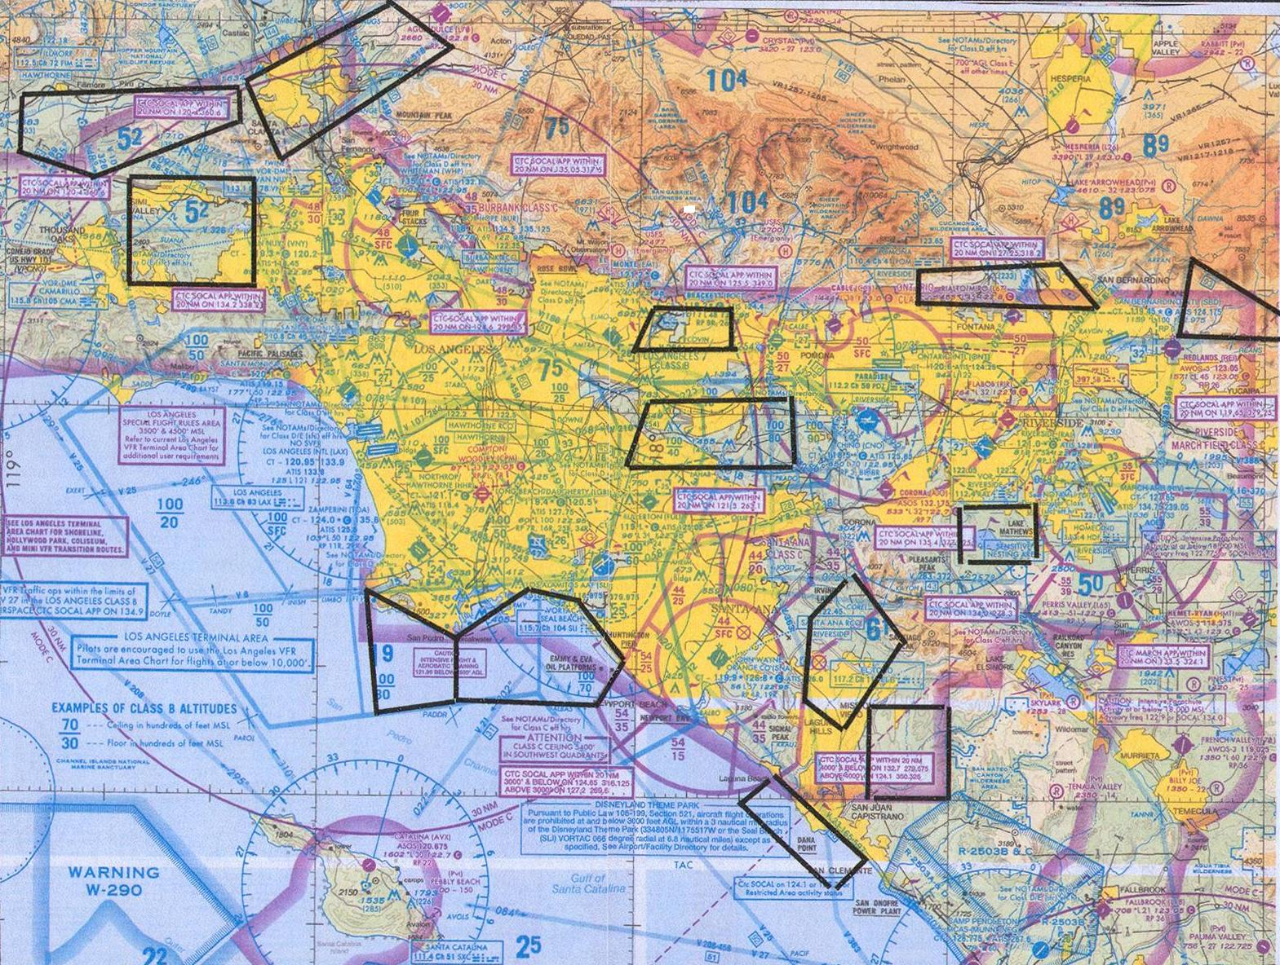
PRACTICE AREAS
The Los Angeles TERMINAL CHART includes 13 Flight Training areas indicated by a magenta CAUTION BLOCK containing the area title, altitude, and frequency.
The boundaries of these areas are not charted. However, SCAUWG has drawn candidate or general guideline boundaries in this presentation. These boundaries are shown in many FAAST seminars.
This data is provided solely as a guide for pilots flying in the Los Angeles Basin and in no way, represents fixed boundaries or other regulatory airspace designated by the FAA.
Notes:
The “legal stuff” … There are 13 areas in the Los Angeles Basin used for practice by students as well as pilots working on enhanced ratings – and in at least three cases, aerobatic training. This presentation was developed by Al German, CFI (retired), while working with Orange County Flight Center. The reference lines that designate the practice areas are general in nature and represent discussions by Mr. German with flight schools in each of the areas designated. This data is provided solely as a guide for pilots flying in the Los Angeles Basin and in no way, represents fixed boundaries or other regulatory airspace designated by the FAA. It is made available for use by pilots by Mr. German and the Southern California Airspace Users Working Group.

Slide 2
Practice Areas in the Los Angeles Basin
Notes:
Generally speaking, these practice areas are on the perimeters of various Class B or Class C airspace. So pilots in training must not only look out for each other; but must be aware of the traffic routes to-and-from these high-use designated airspaces. A separate slide presentation entitled “LA Basin Hot Spots” features a number of pretty specific spots within some of these training areas that have surfaced as problems due to the “mix-of-traffic” types; i.e. the mix of training flights with aircraft en route to-or-from one of the high-use airports.

Slide 3
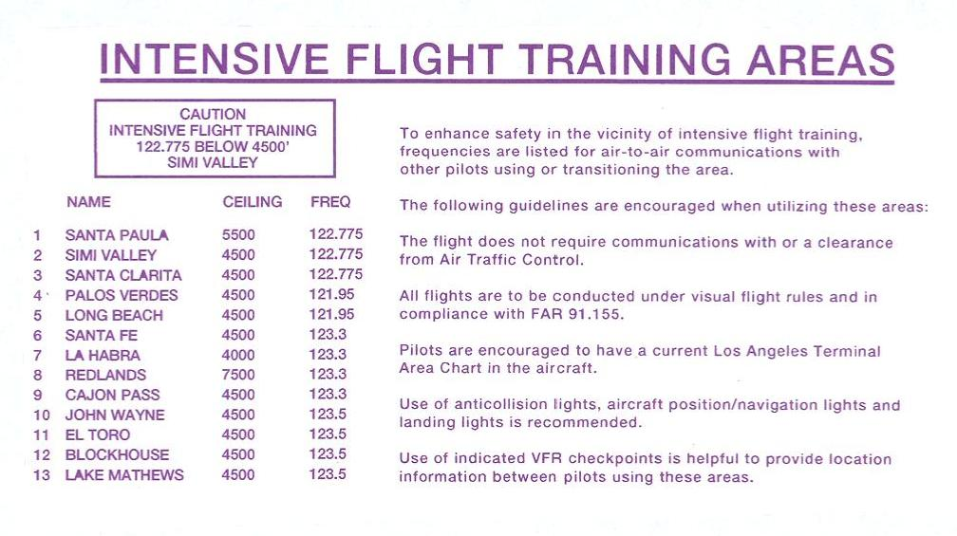
Notes:
The frequencies for each of the practice areas are listed to the left of the lower left corner of the Los Angeles Terminal Area Chart. These frequencies are for communication among pilots training in these areas; and should be monitored by pilots flying through the airspace. However, not all pilots are aware of the extent of these practice areas; and equally important, many en route pilots transiting these practice areas are working with ATC and my not have time or think to monitor VFR practice area frequencies.

Slide 4
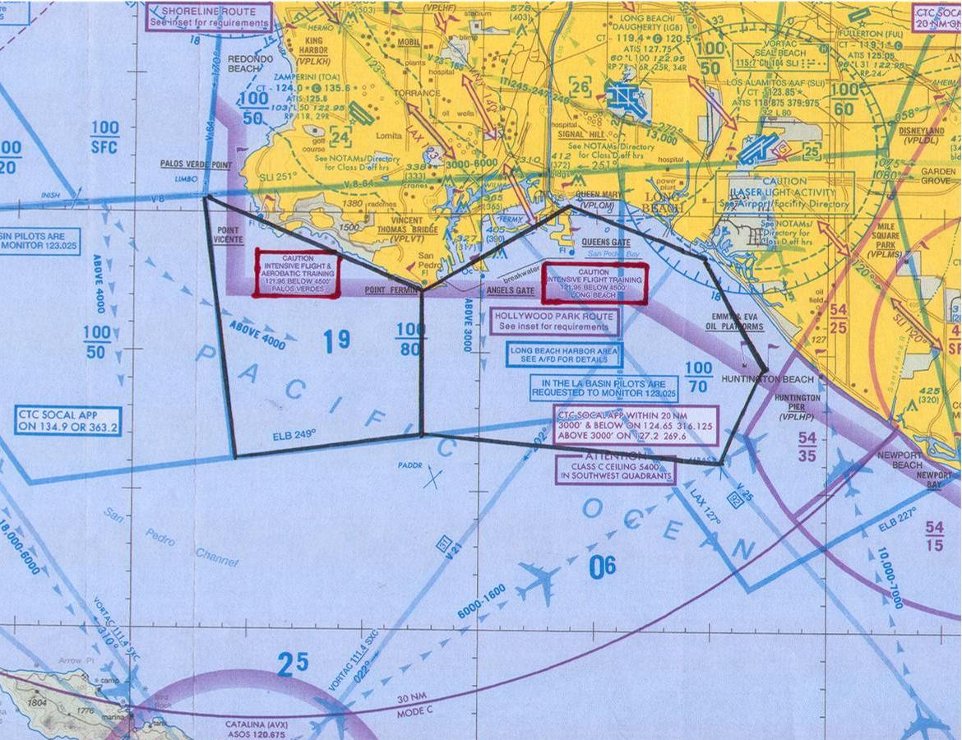
Palace Verdes Long Beach
Notes:
Notice how the training areas extend in different forms from the “magenta” box that designates the area as a practice area; and provides the name of the where the plane is working. Also note in the Long Beach practice area, all of the other “notices” that airmen are supposed to be responsive to. In the six boxes displayed in the Long Beach practice area, there are currently six to seven different frequencies that should be used depending on what the pilot is doing or intending to do – 129.9 below 1000; 121.95 at or above 1000 but below 4000; 134.9 for the Hollywood Route; 134.2 for the Shoreline Route; 124.65 for ATC below 3000; 127.2 for ATC above 3000; and to monitor 123.025 when operating in the LA Basin (Coast Guard frequency).

Slide 5
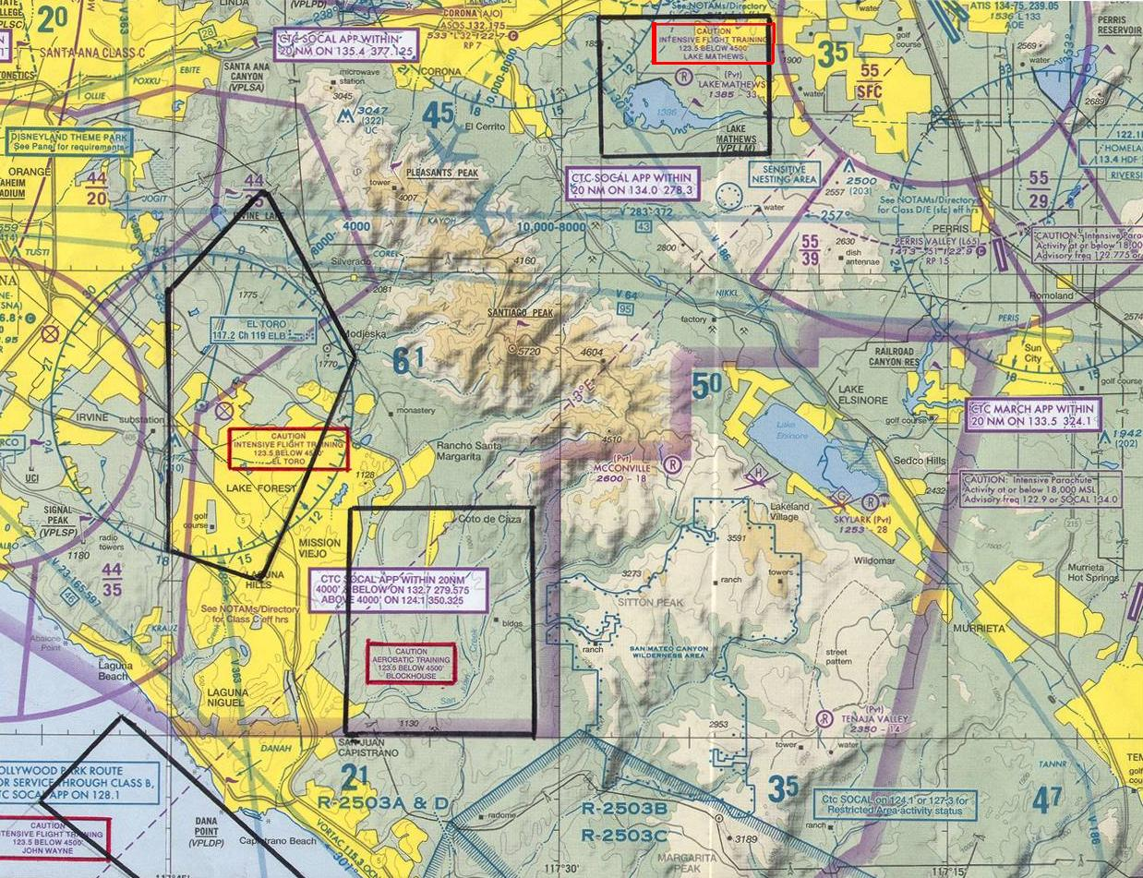
John Wayne
El Toro Blockhouse Lake Mathews
Notes:
The John Wayne practice area is NOT the area just east of the airport – that’s El Toro practice area. John Wayne practice area is the one off the coast that stretches from about the Newport Beach harbor area down to San Clemente. John Wayne practice area often has traffic traversing up-and-down the coastline; channeled there by the Camp Pendleton restricted airspace to its Southeast and the John Wayne Class C airspace ahead.
El Toro lies just to the east of the John Wayne Orange County airport. While part of this airspace is covered by the Class C airspace, the least restrictive VFR approaches to Orange County are right through the middle of this airspace … from the north, the east, and the south. Since the Orange County Class C airspace border cuts through the middle of this practice area, inbound pilots are often preoccupied with contacting SOCAL approach rather than looking for student or practicing pilots.
The Blockhouse practice area has higher terrain, which forces training activities into higher altitudes. More important, it’s contains a non-designated aerobatic training area. Michael Church of Sunrise, in replying to the question, “Does Sunrise have a local aerobatics area,” replies << Yes we do, inland from San Juan Capistrano -- in constant aerobatic use since 1984. It is free of all airspace restrictions, subject only to the 3 mile visibility and 1500' AGL rules. The area is large enough to accommodate 4 planes at a time. >>. SCAUWG has lobbied for and now expects the top of this airspace to be raised to 6000’ with the release of the next Los Angeles Terminal Area Chart.
Lake Mathews is a densely populated training area because it is comparatively small, but the only designated practice area close to Corona and Chino; and convenient to Riverside and Flabob. It is trapped to the east by Class C airspace; to the south by mountains; and to the west and north by both Class D and Class B airspace. With the various airspace constrictions, VFR traffic frequently transits the borders of this practice area.

Slide 6
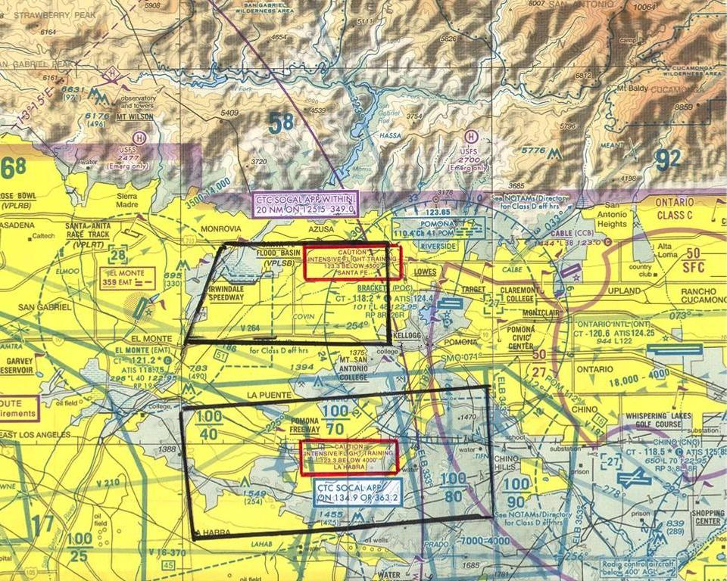
Santa Fe La Habra
Notes:
Santa Fe dam practice area serves El Monte and Bracket fields primarily; but it has raising terrain under it and is squeezed between the mountains to the north and the LAX Class B airspace to the south – making it a busy transit area for en route VFR traffic working its way across the LA Basis and into the San Fernando Valley area or headed from the north to the Riverside area or out through the Banning Pass area. The La Habra practice area, serving Fullerton and Bracket, is similarly “endowed”. It has rising terrain below it … and is capped on top by the base of the LAX Class B airspace. Thus traffic from the southern coastal areas seeking to transit to the north are often flying through this airspace under the Class B airspace while having to clear the 1500’ mountains below by 1000’.

Slide 7
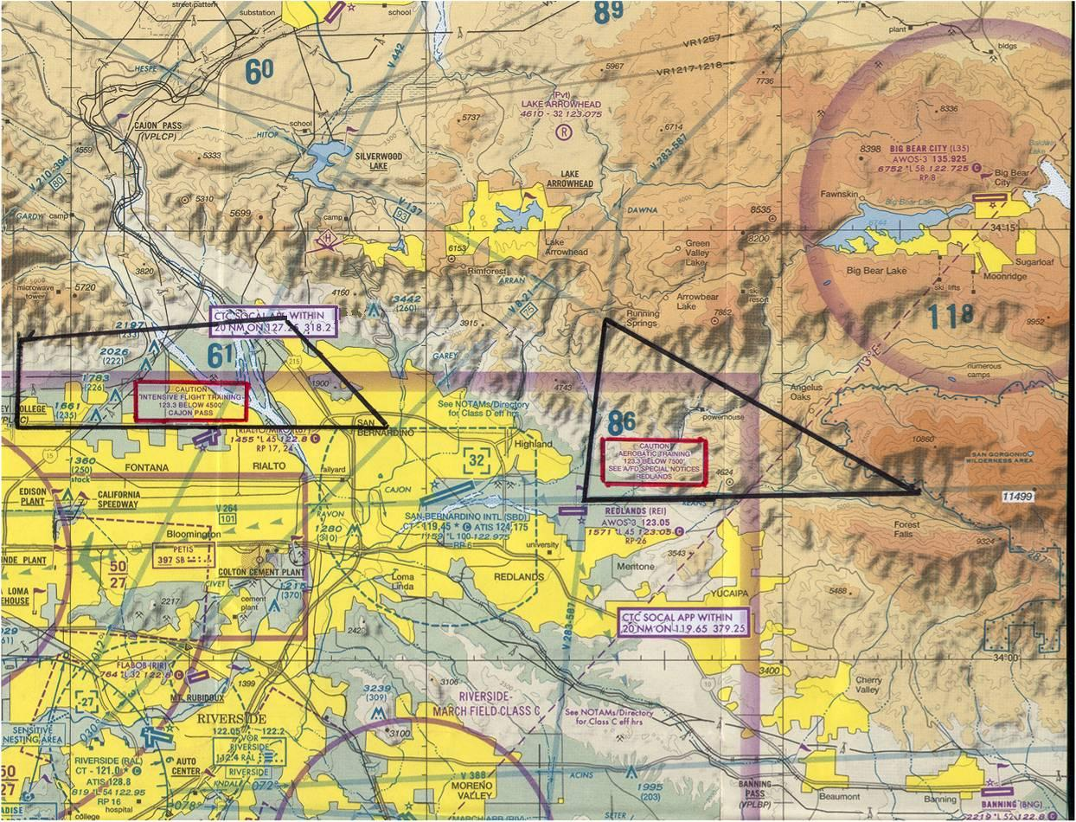
Cajon Pass Redlands
Notes:
The Cajon Pass practice area has multiple challenged. It too is squeezed between high mountains on the north and airspace restrictions to the south; in this case, Ontario’s Class C airspace. VFR Traffic flying east that begin north of the LAX Class B airspace are further channeled into an even narrower chute; which also happens to be the Cajon Pass practice area. And for many VFR pilots … particularly those based in the Corona, Chino, Riverside and San Bernardino areas … the Cajon Pass is the lowest area to cross the mountains if intending to go to Las Vegas and/or Palmdale/Lancaster. Thus traffic at the east end of the practice area is varied and often preoccupied with navigation issues rather than looking for practicing pilots.
Redlands is unique because, in addition to student training and very rapidly rising terrain – Redlands has an FAA designated aerobatic training area within its boundaries that extends from 1500’ agl up to and including 7500’ msl. This aerobatic airspace is for waiver holders only; but it still requires pilots to be alert in the area. And as with the Cajon Pass, pilots coming from Las Vegas down the airway or departing out of Big Bear airport and headed for the LA Basin are often commencing their descents into the basin – potentially right in the middle of where pilots are flying aerobatics. The frequency for communicating in this area is 123.3; not the Redlands airport (REI) multicom frequency 123.05.

Slide 8
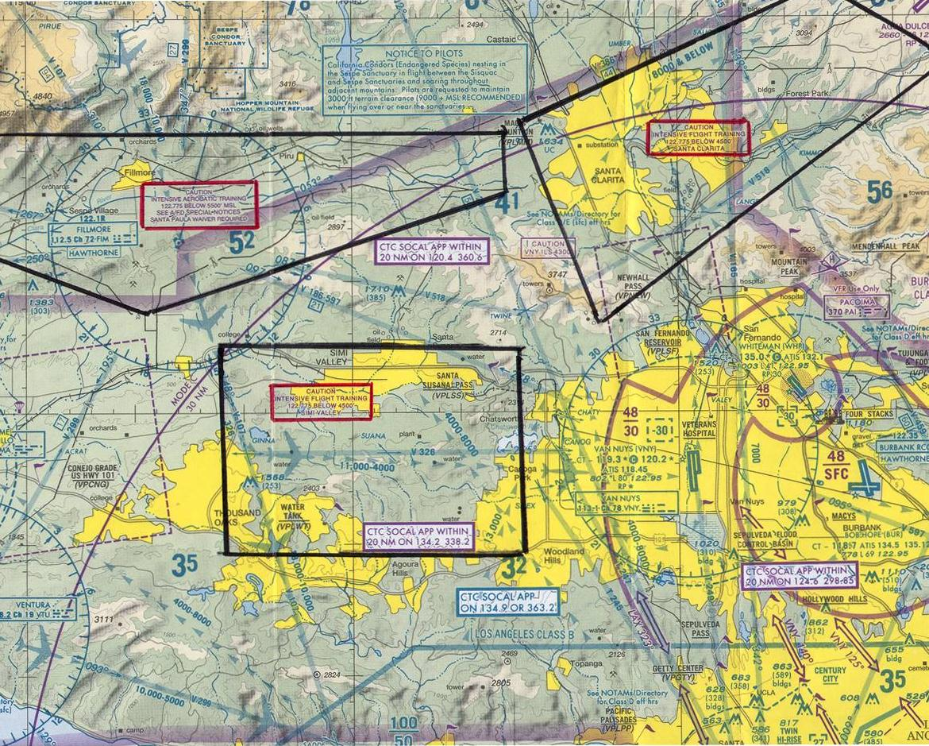
Santa Paula Santa Clarita Simi Valley
Notes:
Santa Paula, like Redlands, has an FAA designated aerobatic flight and training area within its boundaries.
The Van Nuys FAA wants to emphasize that the Santa Paula Aerobatic Practice Area (1500' agl to 5500' msl) that extends all the way from Santa Paula airport (SZP) to Magic Mountain at the east end of the practice area. Like Redlands, this is waivered airspace due to the 91.303 restrictions (Federal Airways) ... requiring application to the VNY FSDO. The frequency for aerobatic area users and pilots transiting this this space is 122.775 (for locals, not the 122.9 multicom frequency of Santa Paula (SZP)). Another key aspect to the Santa Paula practice area is that the Fillmore VOR sits pretty much in its middle. Fillmore is one of the primary LAX jet traffic inbound primary decent routing points. And Fillmore VOR is a hub-point for multiple airways entering or exiting the LA Basin. With mountains immediately to the north and a pseudo-jet traffic flow above; pilots en route west or north tend to channel along the edge of the mountains without realizing that they are also in a designated aerobatic area.
The Van Nuys ILS approach lies just east of the middle of the Santa Clarita valley practice area. And the route east of Santa Clarita is the low pass through the mountains that leads out to the Lancaster/Palmdale areas. Similarly, the Simi Valley practice area is under both a major airway and the ILS approach to Burbank. There are numerous “Hot Spots” in these areas and a visit to the “Hot Spots” presentation at SCAUWG should be considered.

Slide 9
Questions?
This presentation is available at http://www.scauwg.org
Notes:
Generally speaking, these practice areas are on the perimeters of various Class B or Class C airspace. So pilots in training must not only look out for each other; but must be aware of the traffic routes to-and-from these high-use designated airspaces. A separate slide presentation entitled “LA Basin Hot Spots” features a number of pretty specific spots within some of these training areas that have surfaced as problems due to the “mix-of-traffic” types; i.e. the mix of training flights with aircraft en route to-or-from one of the high-use airports.

