Slide 1
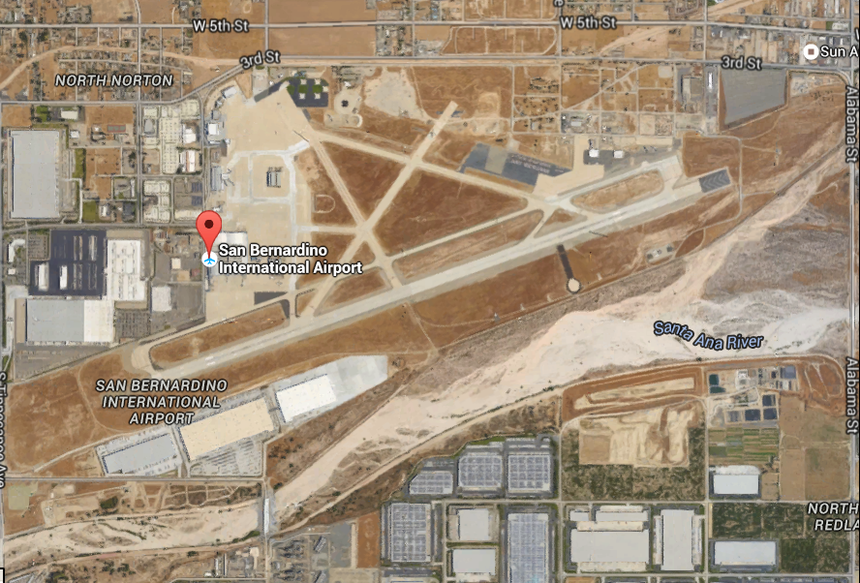
San Bernardino International Airport
Need for FAA integrated Radar Capability
Notes:
Slide 1: This is a “Google” snapshot of San Bernardino International Airport. San Bernardino is the only airport in the Los Angeles Basin with a control tower – that does not also have radar. KSBD is home for the U.S. Forest Services Western Regional Large Air Tanker fire operations and the San Bernardino County Sheriff’s air squadron. KSBD needs radar.

Slide 2
2015 | Itinerate Ops |  |  |  |  |  |  |  |  |  | Local Ops
 | IFR |  |  |  |  | VFR |  |  |  |  |  |  |  | Total SBD Ops
Month | Air Carrier | Air Taxi | General Aviation | Military | Total IFR Ops | Air Carrier | Air Taxi | General Aviation | Military | Total VFR Ops | Civil | Military | Total Local Ops
January | 2 | 35 | 160 | 13 | 210 |  | 15 | 996 | 1 | 1012 | 1442 |  | 1442 | 2664
February | 3 | 38 | 147 | 21 | 209 |  | 10 | 1234 | 11 | 1255 | 1052 | 24 | 1076 | 2540
March | 2 | 32 | 189 | 16 | 239 |  | 19 | 1463 | 14 | 1496 | 1556 | 64 | 1620 | 3355
April | 7 | 28 | 174 | 10 | 219 |  | 19 | 1352 | 4 | 1375 | 1310 | 0 | 1310 | 2904
May | 2 | 38 | 219 | 20 | 279 | 2 | 41 | 1523 | 17 | 1583 | 1418 | 32 | 1450 | 3312
June | 7 | 60 | 186 | 10 | 263 | 106 | 282 | 1846 | 8 | 2242 | 1400 | 24 | 1424 | 3929
July | 6 | 72 | 177 | 14 | 269 | 39 | 132 | 1905 | 27 | 2103 | 1682 |  | 1682 | 4054
August | 2 | 70 | 160 | 6 | 238 | 14 | 298 | 1945 | 12 | 2269 | 1464 |  | 1464 | 3971
September | 44 | 84 | 147 | 21 | 296 | 2 | 124 | 1437 | 8 | 1571 | 880 | 18 | 898 | 2765
October | 28 | 56 | 175 | 7 | 266 | 2 | 102 | 1626 | 4 | 1734 | 1204 | 4 | 1208 | 3208
November | 33 | 44 | 175 | 5 | 257 | 1 | 162 | 1667 | 21 | 1851 | 1705 | 26 | 1731 | 3839
December |  |  |  |  | 0 |  |  |  |  | 0 |  |  | 0 | 0
2015 Totals: | 136 | 557 | 1909 | 143 | 2745 | 166 | 1204 | 16994 | 127 | 18491 | 15113 | 192 | 15305 | 36541
Notes:
Slide 2: Here is a snapshot picture of the Itinerate and Local operations at the airport in 2015 (except December). The arrow points to the total operations -- 36,541. But that’s not the whole story as you’ll see in the next few slides.

Slide 3
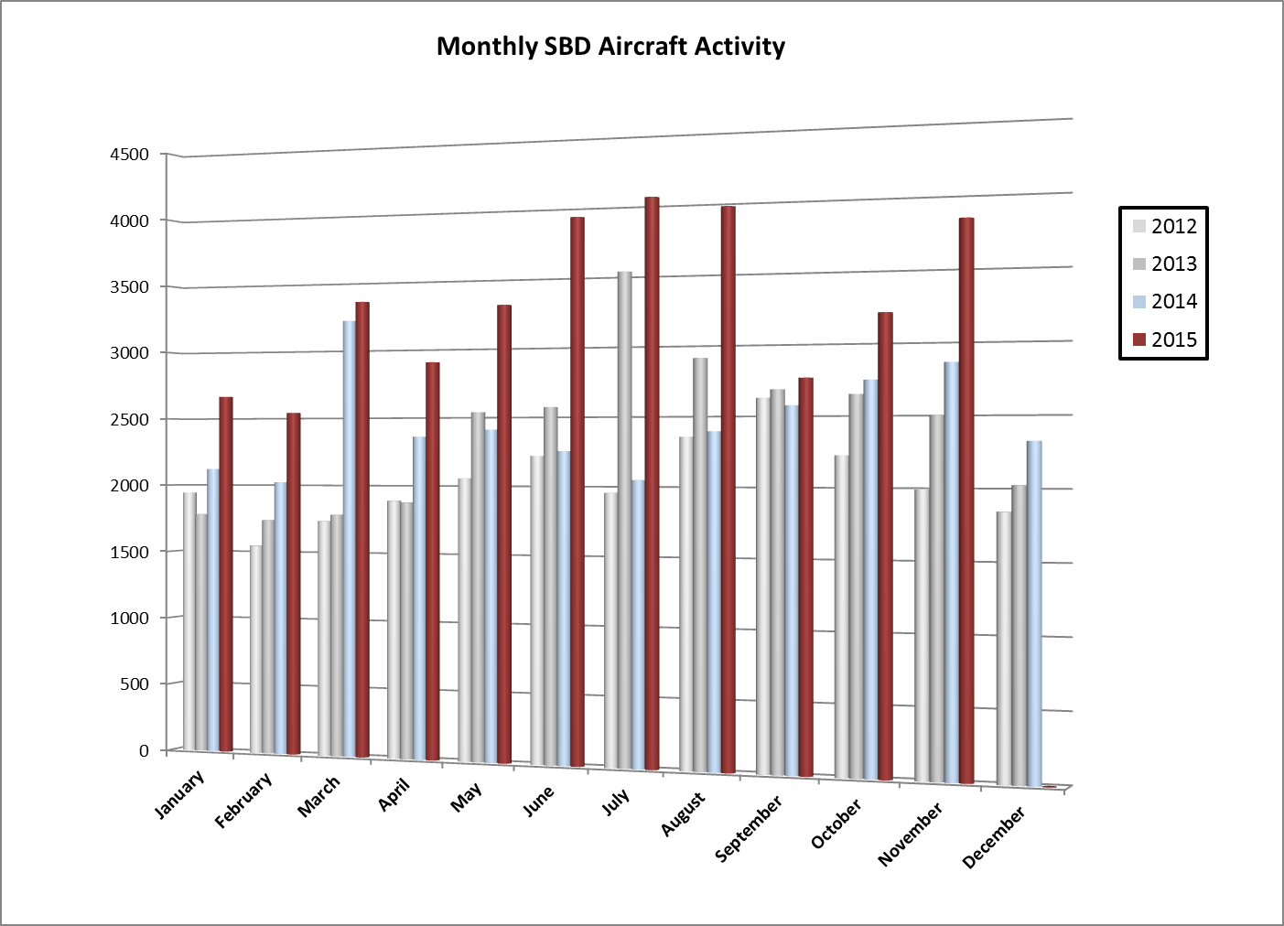
Notes:
Slide 3: This graph depicts the past four years of growth at San Bernardino International. The maroon bars depict 2015. Note the continued and increasingly disproportionate growth (i.e. how far the maroon bars exceed previous months)

Slide 4
Over Flights
 | Total SBD Tower
Total OverFlights |  | % OverFlights
722 | 3386 | 21%
696 | 3236 | 22%
772 | 4127 | 19%
728 | 3632 | 20%
737 | 4049 | 18%
618 | 4547 | 14%
692 | 4746 | 15%
644 | 4615 | 14%
675 | 3440 | 20%
783 | 3991 | 20%
758 | 4597 | 16%
0 | 0 | 0%
7825 | 44366 | 18%
Notes:
Slide 4: In slide 2, I noted “there’s more.” This set of numbers depicts the number of known “over flights” through the San Bernardino airspace by month – on the left. These are aircraft that transited through the airspace but did not land or takeoff. The center column represents the total number of tower contacts with aircraft in their airspace. The arrow points to 44,366 separate aircraft interactions. NOTE to the right of the arrow – these “over flights” represented 18% of the tower operator’s activity!

Slide 5
Notes:
Slide 5: This depicts the over flights month by month in 2015 – and you can see that it is a fairly consistent pattern month after month – ranging from 14% to over 22% in some months.

Slide 6
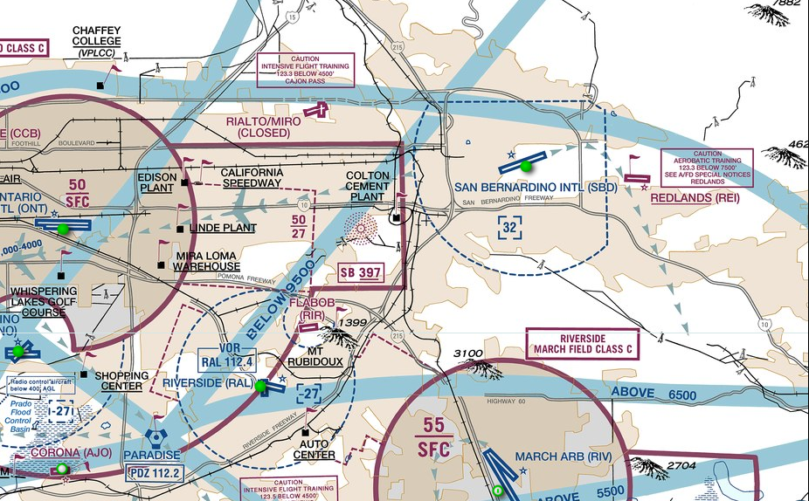
Los Angeles Flyway Chart
Notes:
Slide 6: This is the KSBD area captured from the Los Angeles Flyway Chart (on the back of the TAC).
[First Blue Arrow] This is KSBD. Note the irregular shape of the Class D airspace – 5 mile circular on the west and south and 2 miles flat on the north and east. Why the FAA does things like this is sometimes confusing – but I’ll discuss some of the logic in the next slide. What’s important about this slide is …
[Second Blue Arrow] This is the Ontario Class C airspace. Note that eastern edge of the 2700’ umbrella literally abuts the western edge of the KSBD airspace.
[Third Blue Arrow] This is the March Air Force Base Class C Airspace. It goes to the surface. March has recently become a multi-use facility; and now serves both military and general aviation aircraft as well (mostly business and charter jets).
[Forth Blue Arrow] This is the Paradise VOR. It is the primary navigation aide in the Inland Empire. San Bernardino, Chino, Corona, Riverside, and Ontario all have instrument approaches that use Paradise as a primary fix. Note also the various suggested traffic flows at flight levels above the surrounding Class C airspace.

Slide 7
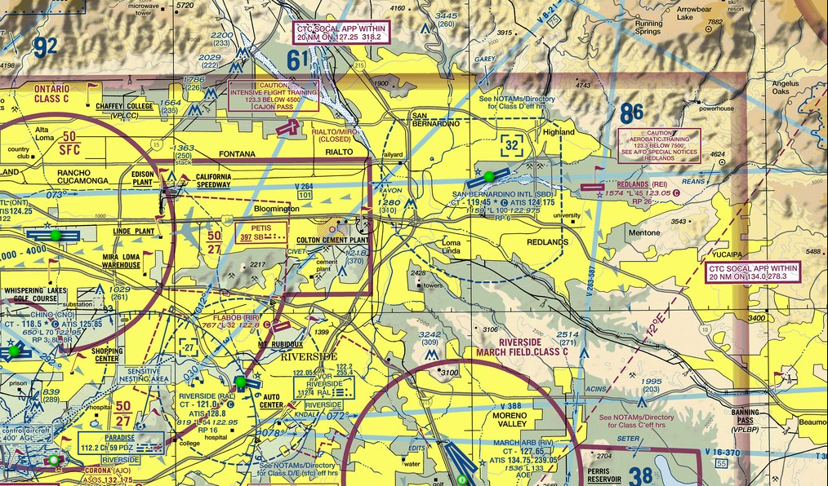
Los Angeles Terminal Area Chart (TAC)
Notes:
Slide 7: This is a fairly complex slide. [White Arrows] The white arrows at the top point to the mountains that surround the eastern edge of the Los Angeles Basin – rising to between 6000’ and 8500’ in this part of the Basin. [First Blue Arrow] San Bernardino sits at the crux of a number of conflicting airspace problems.
The mountains, combined with the [Second Blue Arrow] Ontario Class C airspace and the [Third Blue Arrow] March Class C airspace – with the further nesting of the Riverside Class D airspace filling the southeast corner of the Ontario umbrella -- force VFR traffic flying in the eastern end of the Los Angeles Basin into distorted travel patterns.
[First Red Arrow] For starters, VFR traffic flying not able or not wanting to talk to air traffic control … are forced through a very narrow channel between the Riverside Class D airspace the March Class C airspace. And even those that communicate with Riverside must generally remain east of the Ontario Class C umbrella.
[Second Red Arrows] These red arrows depict the primary exit routes for VFR traffic out of the Los Angeles Basin. The red arrow on the left points indicates the primary route to the Cajon Pass (i.e. towards Las Vegas). The red arrow on the right indicates the primary route toward Banning Pass (i.e. towards Palm Springs and the Mexican border).
Keep in mind that each of these routes have major freeways as ground reference for pilots [point them out]. These freeways go these routes because they represent the lowest passes out of the Basin. Note that all three converge inside the San Bernardino Class D Airspace!
It is not possible to determine how many VFR flights transit along these routes departing or entering the LA Basin – and in so doing, pass through the San Bernardino Class D airspace. Without radar, tower personal are dependent on pilots reporting that they are transiting.
And even this isn’t particularly reliable. I departed San Bernardino this past Thursday on a northwesterly heading … and was told that there was advised by the tower that there was news helicopter at 2000’ northwest. I searched and searched … and finally found the helicopter in my direct line of flight at the altitude I’d reached at 3500’ (i.e. above the Class D airspace … hovering while covering a fire on the ground).
[Fourth Red Arrow] This is Redlands Airport. Redlands Airport would fit within the Class D airspace of San Bernardino if the normal 5 mile circle were in place. KSBD’s airspace is limited to about 2 ½ miles … apparently to allow for the normal traffic pattern at Redlands. Redlands operates with its pattern(s) on the north side of the airport (i.e. right hand pattern for Runway 26 : left hand pattern for Runway 8).
San Bernardino operates its patterns on the south side of the airport (i.e. left hand pattern for Runway 24 and right pattern for Runway 6)
Now I have personally flown left base for Runway 24 and looked to my right to see, less than a mile away, a Cirrus aircraft on a cross-wind entry to Redlands Runway 26.
Keeping in mind that Redlands has a high student pilot level of training … and San Bernardino has a high level of large and small jets and turbo props in its operational mix – this little corridor of airspace is an “accident waiting to happen.”
A disproportionate number of major fires are in the mountains surrounding the LA Basin. When those fires are to the east … tanker aircraft come down off those mountain slopes directly to KSBD for rapid replenishment of fire retardant.
Keep in mind … this is all with the protection of radar.

Slide 8
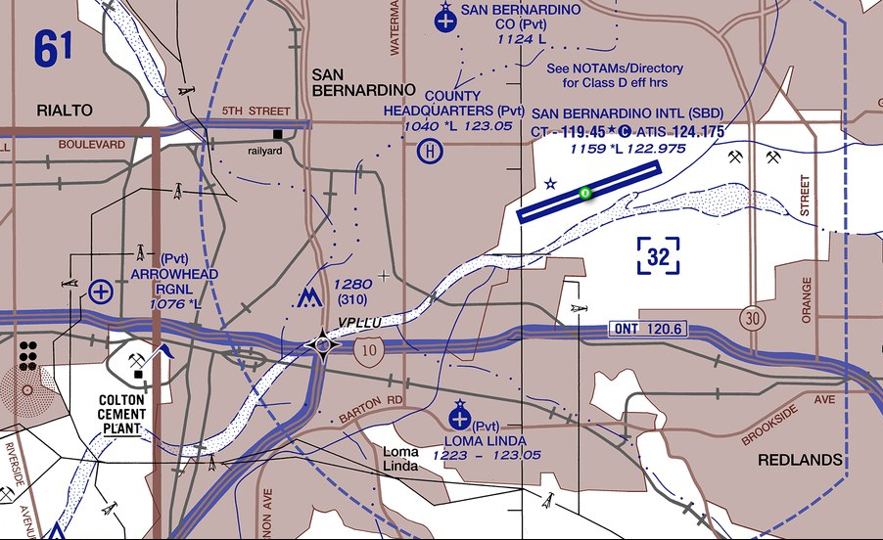
Los Angeles Helicopter Chart (Old)
Notes:
Slide 8: To add to the complexity of [First Blue Arrow] San Bernardino International Airport, as noted earlier, the San Bernardino County Sheriff’s Squadron is based here. During emergencies, Sheriff’s helicopters depart from the airport directions representing a clock – 360 degrees of departure routes – often at high speed.
To add further complexity [First Red Arrow], Loma Linda University has a Trauma One Level emergency Hospital with two helipads. It serves virtually all of the Inland Empire … as well as the desert communities on the other side of the mountains! The helipads are inside the San Bernardino Class D airspace. Emergency helicopters arrive from all directions to the hospital. [Second Red Arrow] In addition to the Trauma One Level hospital in Loma Linda, the Arrowhead Regional Hospital serves as a Trauma Level Two emergency center. It is just west of the Class D airspace and also has two helipads.

Slide 9
What’s Changed since last visited (5 years ago)
Air traffic has increased over 50% since 2013
Increasing activity to continue …
30 new general aviation hangars on-line by the spring of 2016
FBO 2013 and Aggressive marketing program established in 2014
US Customs established over-flight exemption allowing international traffic to clear Customs at SBD rather than traditional border airports; international clearances have increased over 300% since 2013
Forest Service Operations Expanded
Sheriff’s Department Relocated from Rialto to KSBD
Helicopter Training from Redlands has increased
Emergency Helicopter Activity has increased
Loma Linda Trauma Center
Arrowhead Regional Trauma Center
Redlands Airport activity has increased
Virtually unknown number of non-reported traffic passes through without calling KSBD
Redlands arrivals/departures
Cajon Pass – Banning Pass traffic
Notes:
Slide 9: Five years ago, the San Bernardino International Airport attempted to get an FAA radar feed for its tower. At that time, the FAA determined that there was not enough volume to warrant a radar feed. But a great deal has changed at San Bernardino in the past 5 years. [Talk to bullet points on the slide : Also note that Redlands says they have What’s Changes since last visited (5 Years Ago)
Note: Redlands “says” they have 32800 local and 11200 itinerant to equal 44000 VFR operations a year! There is no way to validate that number beyond that is what has been reported to the FAA as sourced from the AirNav.Com and other internet sources.

Slide 10
SBIAA Perspective
The radar equipment/feed would require SBIAA to fund the project through a reimbursable agreement with the FAA (whereby SBIAA would deposit funds
for the equipment/feed upfront – typically 5 years)
and the FAA would utilize the funds over the term
of the agreement to maintain the equipment/feed
through its proprietary network. The SBIAA board
would make the final determination on the
expenditure of funds, and would very likely
recognize the benefits of a radar feed.
Mark Gibbs
Director of Aviation
Notes:
Slide 10: [Talk to paragraph on the slide]

Slide 11
SUMMARY
KSBD only towered airport in LA Basin without radar
KSBD traffic departs west and south directly into or under Class C Airspace (arrivals come from …)
SBIAA appears willing to fund the solution
Safety for all will be greatly enhanced
Emergency traffic
Sheriff’s traffic
Forest Service big tankers
Redlands arrival/departure
Expanding rapid growth at KSBD
It’s clear that there is a need!
Notes:
Slide 11: [Talk to bullet points on the Slide]

Slide 12
Richard Eastman
CFIIMEI
FAAST Representative
PO Box 1116 : Cedar Glen : CA 92321
+1 714 404 3325
reastman@eastmangroup.com
Notes:
Slide 12: I hope you now understand why there is a very real need for radar at the San Bernardino International Airport. With supportive funding from the Airport Authority, there should be no reason to delay further.
Thank you for your time.

