Slide 1
FY2018 Runway Safety Action Team (RSAT)
meeting for LONG BEACH/DAUGHERTY FIELD (LGB) Airport

Slide 2
Introduction
Welcome to the Runway Safety Action Team (RSAT)
  Air Traffic Manager: Tom Monahan
  Airport Manager: Jess Romo
Please enter name, organization, and contact information on the sign-in sheet

Slide 3
Agenda
Runway Safety Briefing
  Overview of the RSAT Process
  Definitions and National Statistics
  National Trends and Topics
RSAT Open Discussion
  Local Incident History
  Local Action Item Review
  Identify local risk factors and/or current initiatives
  Stakeholder / User Perspectives
Outcome: Develop RSAP and Action Items

Slide 4
RSAT Process Overview
Purpose: To bring local stakeholders together at least once per year to identify and mitigate the risks of significant surface events at your airport.
Process:
  Review Incident History
  Review Action Item History
  Discuss Current Concerns
  Create FY2018 Runway Safety Action Plan and Action Items
Notes:
The RSAT’s job is to look objectively at your airport and determine what you can do to improve surface safety.
Encourage your team (everyone in the room) to speak up – ask questions of them to encourage conversation.
Set the tone for this meeting:
All participants are encouraged to freely discuss issues and safety concerns for the purpose of reducing risk and improving safety of operations.
Encourage no-fault discussion. Take an objective look at your airport and past events without assigning blame.
Discuss the good and the bad. Local successes and best practices can make a good model for other airports.

Slide 5
Definitions
Runway Incursion: The incorrect presence of an aircraft, vehicle or person on the protected area of a surface designated for the landing and take-off of aircraft. (This includes the Runway Safety Area (RSA).)
Runway Excursion: A veer off or overrun off the runway surface.
Surface Incident: Unauthorized or unapproved movement within the designated movement area (excluding runway incursions) or an occurrence in that same area associated with the operation of an aircraft that affects or could affect the safety of flight.

Slide 6
Definitions
Types of Surface Events:
Operational Incident (OI) – A surface event attributed to ATCT action or inaction.
Pilot Deviation (PD) – A surface event caused by a pilot or other person operating an aircraft under its own power.
Vehicle or Pedestrian Deviation (VPD) – A surface event caused by a vehicle driver or pedestrian
Other – Surface events which cannot clearly be attributed to a mistake or incorrect action by an air traffic controller, pilot, driver, or pedestrian will be classified as “other.” These events would include incursions caused by equipment failure or other factors.

Slide 7













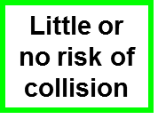
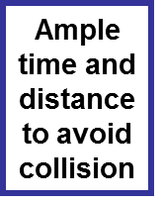
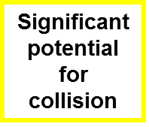
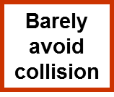

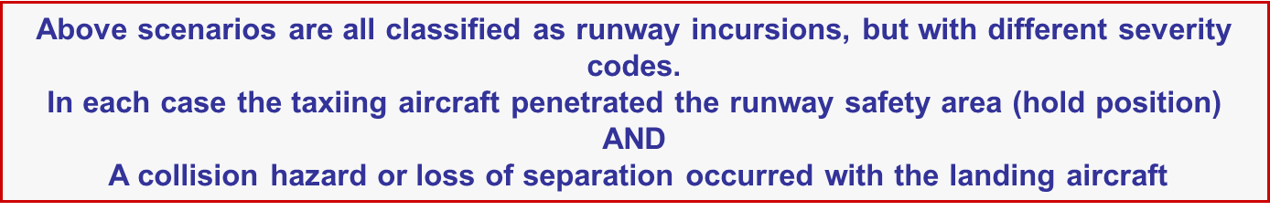
Definitions - Severity Category

Slide 8
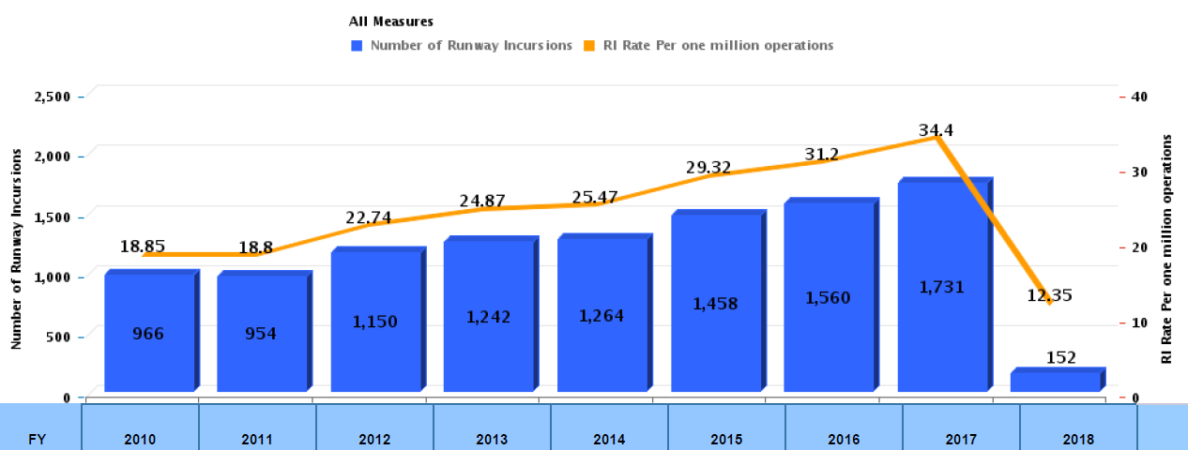
National Statistics
Total Runway Incursions by Fiscal Year
Data current as of 1/1/2018

Slide 9
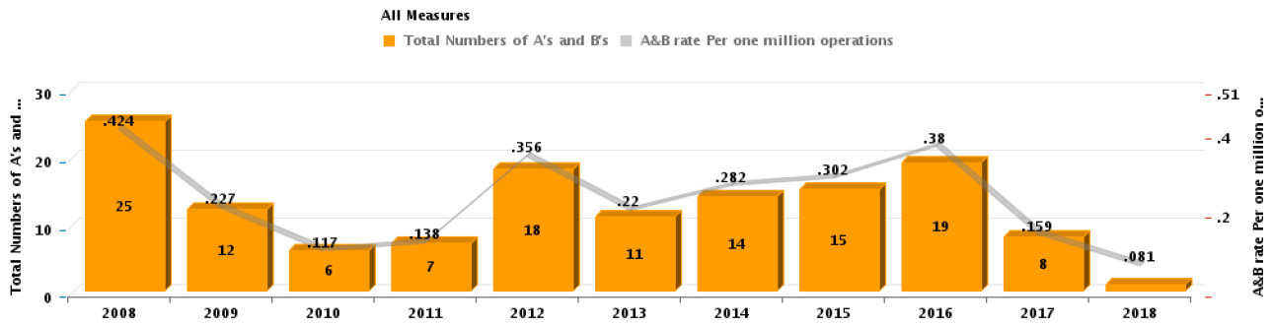
National Statistics
Category A and B Runway Incursions by Fiscal Year
Data current as of 1/1/2018

Slide 10
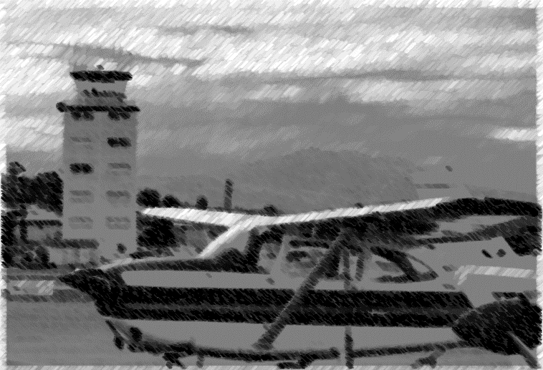
Communications
Communication continues to be a contributing factor in many runway incursions.
Notes:
For example:

Slide 11
Communications
An example scenario:
  Pilot taxies out to Runway 27L.
  Pilot calls ready for takeoff Runway 27L.
  Controller instructs the pilot to cross Runway 27L and expedite for landing traffic, intending for the aircraft to depart Runway 27R.
  Pilot responds “Runway 27L, cleared for takeoff.”
  Controller does not catch the incorrect read back.
  Pilot taxies onto Runway 27L for departure.
  Traffic on short final for Runway 27L is instructed to go around.
Notes:
Ideas for discussion:
What was the pilot expecting? How did that affect his/her actions?
What was the controller expecting? Did the controller clearly communicate that to the pilot?

Slide 12
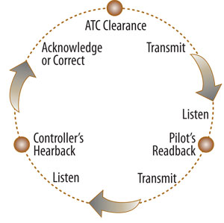
Close the Loop

Slide 13
Communication Best Practices
Complete Read back / Hear back loop
Use Prescribed Phraseology and Standard Format
Maintain Situational Awareness – pay attention to transmissions to other aircraft/vehicles on frequency
Employ appropriate Speech Rate
Ask for clarification when unsure of instructions

Slide 14
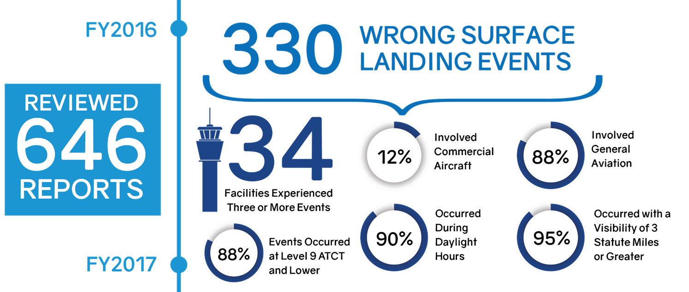
Wrong Surface Landings

Slide 15
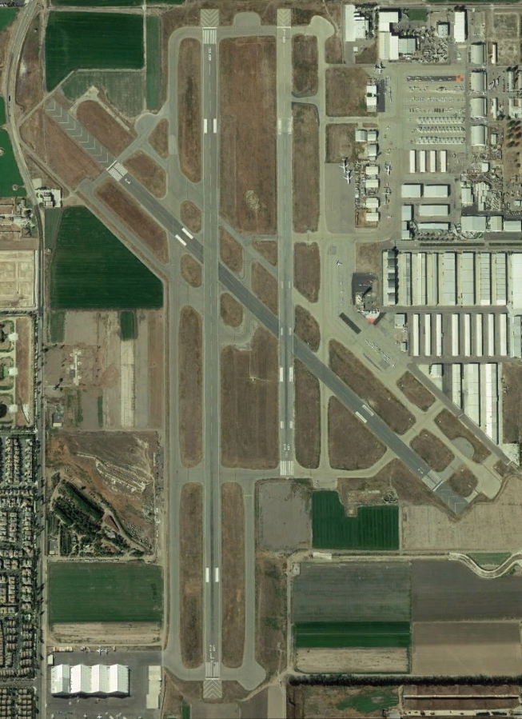
Wrong Surface Landings
Wrong Surface Landings include wrong runway, taxiway, and wrong airport landings.
Common geometric factors include:
  Parallel runways
  Closely aligned runway ends
  Parallel taxiways confused for runways
Notes:
Discussion: Do you have parallel runways at your airport? Runways with closely-aligned ends? Is there a similarly-configured airport nearby that could cause confusion? Do you have wide taxiways that could be confused for a runway? Discuss “not in sight”. Flyer (?) can be printed out to offer to instructors, flight schools or FBOs.

Slide 16
Pilot Expectation Bias
Pilot expectation bias is the most common contributory factor in wrong surface landings, typically because the clearance received was outside of what he/she expected as “normal practice.”
Examples of “norms”:
  Full stop landings are assigned the runway nearest to the ramp.
  Pilots switched to a different runway are normally changed to a different frequency
  Pattern entry matches runway assignment, i.e. left traffic pattern = left runway.
Notes:
In a recent study, pilot expectation bias was the most common contributory factor in wrong surface landings. Pilots correctly read back the runway assignment but landed on a different runway. The most common reason given was the clearance was outside of what he/she expected as a normal practice.
Information taken from June 2017 ATO Quality Assurance (QA) Bulletin.
Does your airport have any operating “norms” that might lead pilots to expect a certain clearance?

Slide 17
Wrong Surface Mitigations
To mitigate the risk of wrong surface operations, every user of the airfield can:
Review the Airport Diagram prior to operation
Review Visual Cues – Runway versus Taxiway
  Paint: White or Yellow
  Lights: White or Blue/Green
Use common Verbal Cues – Use of “Active Runway”
Be familiar with Runway Holding Position Markings
“Close the Loop” with Read back / Hear back
Notes:
Pilots aren’t the only ones who can get confused at the airport. Always have an airport diagram with you and ask for clarification if you are ever in doubt.
Discuss Visual Cues that help differentiate Runway versus Taxiway
Discuss use of the runway numbers for the “active runway” or “runway in use” – that is, Runway 16 as opposed to Runway 34
Discuss Runway Holding Position Markings – Do you have approach holds at your airport? Are pilots and vehicle drivers aware of how to proceed at these locations?

Slide 18
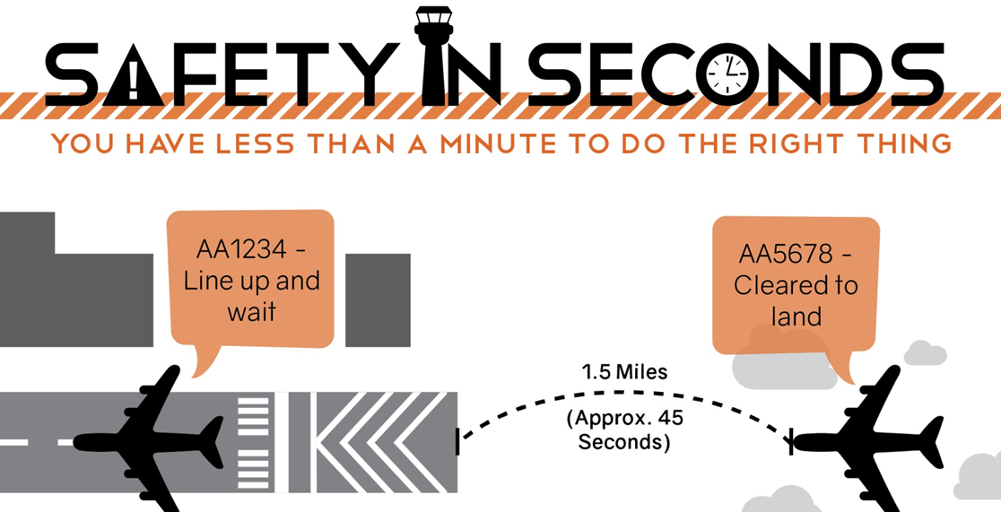
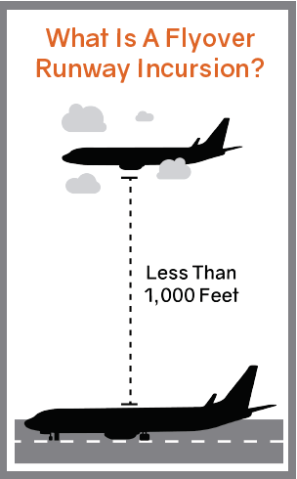
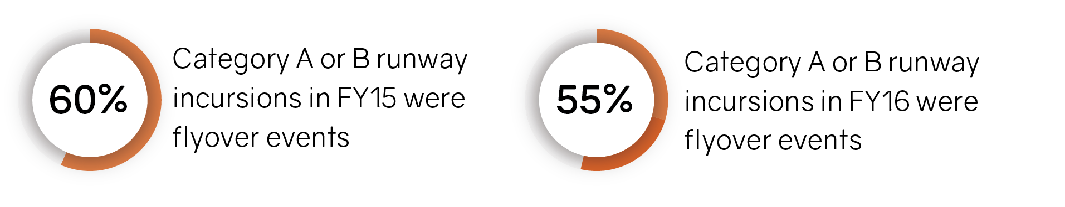
Flyover Events
Event?
Notes:
Events where an aircraft ends up directly over-flying another aircraft, a vehicle or a pedestrian. Because of the high energy and relatively close proximity, these events can often end up being serious.
Runway Flyovers can occur at any airport on any movement area surface. They often pair with wrong surface operations.
Large aircraft may lose more than 100 feet in the time it takes to initiate an unexpected go-around.
Pilots may be unaware of the conflicting traffic:
In LUAW, the aircraft will be facing away from landing traffic
For airborne aircraft, it can be difficult to identify aircraft in position or on the runway, especially at night.
All aircraft, vehicles, and pedestrians should actively listen to all transmissions on frequency and maintain situational awareness of activities/clearances for their runway.

Slide 19
Flyover Risk Mitigations
Air Traffic Control:
Issue timely control instructions
Pilots and Vehicle Drivers:
Listen to all transmissions on frequency when on a runway
Clear final approach course prior to proceeding onto runway
If you are in doubt that the runway is clear - say something
Notes:
Air Traffic Control: Issue timely control instructions, plan accordingly to give pilots enough time to take action. Consider aircraft characteristics and performance. Aircraft are less maneuverable at low speeds and with flaps and landing gear.
Pilots: Verify that your assigned/intended landing surface is free from other aircraft, vehicles/pedestrians, and other obstructions.

Slide 20
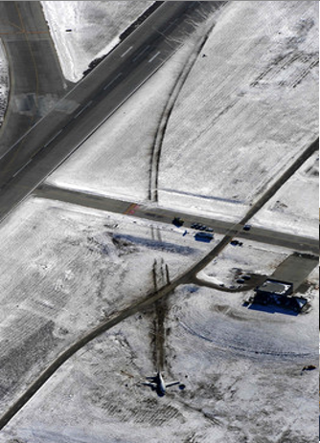
Runway Excursions
Lead to more runway accidents than all other causes combined.*
Estimated annual cost: $900 Million
Causes
  Unstable Approaches
  Runway Contamination
  Adverse Weather / Wind Conditions
  Mechanical Failure
  Pilot Error
Notes:
* From CANSO Runway Excursions: An ATC Perspective on Unstable Approaches

Slide 21
Runway Excursions
Possible Mitigations:
  Stabilized approach below 500’ in VMC and 1000’ in IMC
  Minimize late runway changes and short approaches
  Ensure timely and accurate weather and surface condition reports
  Ensure proper runway selection given the conditions: runway length, contamination, wind speed and direction
Notes:
* From CANSO Runway Excursions: An ATC Perspective on Unstable Approaches

Slide 22
Local Discussion Topics
The following slides are provided to review local events and to promote discussion regarding local concerns, surface risks, and potential mitigations at this airport.
Potential solutions (action items) will be noted and addressed in a later section.
Notes:
Recommend designating a note taker for this section. Record concerns throughout for further development during Action Item process. Consider a “holding pattern” on a white board or note pad.
Focus discussion on lessons learned as opposed to placing blame.

Slide 23
Local Incidents
Review local incidents.
Notes:
At a minimum, the discussion must cover runway incursions and excursions since the last RSAT meeting, including any mitigations implemented as a result.
Try to keep discussions focused on the opportunity to mitigate surface risk and enhance safety, instead of trying to determine fault.
Suggest printing handouts of Airport Diagram with plotted events for attendees.

Slide 24
Action Item Review
Review Action Items.
Notes:
Discuss any open Action Items, plus any Action Items closed since the date of the last RSAT meeting.
Review previous years’ Action Items for effectiveness, as applicable.

Slide 25
Geometry
Does your airport geometry:
    Have any collocated runway thresholds?
    Have parallel runways with offset thresholds?
    Lead to crossings in the middle third of runway (high-energy area)?
    Have unusual marking and/or signage placement?
    Lack a full length parallel taxiway?
    Have direct/short ramp to runway taxi routes?
    Have taxiways in-line with the runway?
    Have intersections with more than three directional choices?
    Have any wide expanses of pavement at a taxiway/runway intersection?
    Have any taxiways entrances at other than a 90 degree angle to the runway?
    Have any taxiways coinciding with the intersection of two runways?
Notes:
All of the geometry characteristics listed are possible contributors to pilot and vehicle driver confusion and can lead to surface events. In some cases, construction may be a solution to these geometric challenges. If construction is not feasible, increasing controller and pilot awareness of these challenges is itself a mitigation.
Are areas with challenging geometry specifically addressed in the tower training program?
Are areas with challenging geometry specifically addressed in pilot training activities at the field?

Slide 26
Hot Spots
Notes:
A hot spot is defined as a location on an airport movement area with a history of potential risk of collision or runway incursion, and where heightened attention by pilots/drivers/controllers is necessary.
Insert diagram and/or close-ups of your hot spots. Discuss any upcoming construction aimed at improving those areas. Has anything changed (signs/marking/lighting, procedures, usage)? Are there any areas not identified as a hot spot that need to be?

Slide 27
Hot Spots
HS 1 Rwy 12-30 and Rwy 07L-25R, Twy B and Twy K.
Notes:
A hot spot is defined as a location on an airport movement area with a history of potential risk of collision or runway incursion, and where heightened attention by pilots/drivers/controllers is necessary.
Insert diagram and/or close-ups of your hot spots. Discuss any upcoming construction aimed at improving those areas. Has anything changed (signs/marking/lighting, procedures, usage)? Are there any areas not identified as a hot spot that need to be?

Slide 28
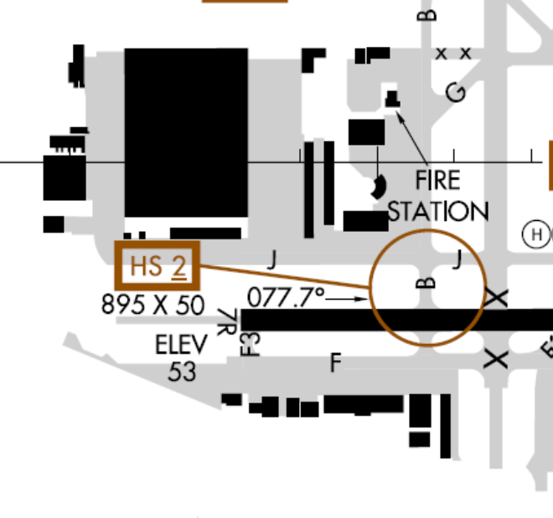
Hot Spots
HS 2 Rwy 07R-25L, Twy B.
Notes:
A hot spot is defined as a location on an airport movement area with a history of potential risk of collision or runway incursion, and where heightened attention by pilots/drivers/controllers is necessary.
Insert diagram and/or close-ups of your hot spots. Discuss any upcoming construction aimed at improving those areas. Has anything changed (signs/marking/lighting, procedures, usage)? Are there any areas not identified as a hot spot that need to be?

Slide 29
Hot Spots
HS 3 Rwy 07R-25L and Rwy 12-30, Twy J and Twy D.
Notes:
A hot spot is defined as a location on an airport movement area with a history of potential risk of collision or runway incursion, and where heightened attention by pilots/drivers/controllers is necessary.
Insert diagram and/or close-ups of your hot spots. Discuss any upcoming construction aimed at improving those areas. Has anything changed (signs/marking/lighting, procedures, usage)? Are there any areas not identified as a hot spot that need to be?

Slide 30
Hot Spots
HS 4 Rwy 12-30 crosses every other rwy.
Notes:
A hot spot is defined as a location on an airport movement area with a history of potential risk of collision or runway incursion, and where heightened attention by pilots/drivers/controllers is necessary.
Insert diagram and/or close-ups of your hot spots. Discuss any upcoming construction aimed at improving those areas. Has anything changed (signs/marking/lighting, procedures, usage)? Are there any areas not identified as a hot spot that need to be?

Slide 31
Construction
Discuss current and/or future plans.
Notes:
Airport sponsor should provide this part of the briefing.
For any upcoming construction projects, ensure that Airport Construction Advisory Council (ACAC) is contacted as required in JO 7210.3 paragraph 10-3-11.a Airport Construction.

Slide 32
Surface Safety Issues
Discuss any surface safety concerns reported to the tower in the past year.

Slide 33
Weather
Discuss any persistent weather conditions that could affect surface safety to include:
  Field conditions that may cause markings to be obscured (snow, ice, standing water, or areas prone to flooding)
  Sun conditions that may compromise visibility

Slide 34
Vehicle Operations
Discuss procedures and training for vehicle operator access to the movement area.
Discuss use of vehicle access roads at your airport.
This may include snow removal procedures and movement controls for vehicle drivers involved in wildlife mitigation.

Slide 35
Wildlife
Discuss procedures and movement controls for vehicle drivers involved in wildlife mitigation.

Slide 36
Letters of Agreement (LOAs)
Review Movement Area LOA with the Airport, and any other LOAs affecting surface operations such as snow removal procedures and use of the Runway Safety Area.

Slide 37
Special Events
Discuss any air shows, civil fly-ins, parachute operations, UAS activities, etc. scheduled in the next year.

Slide 38
Feedback
Discuss any user concerns dealing with aircraft, pedestrian, or vehicle operations on the airport surface.

Slide 39
Best Practices
1. Construction meetings with tower and airports and users re: how tower is going to move airplanes, briefings to the air crews, etc.
2. When feasible, the Air Traffic Manager (ATM) provides tower cab tours as part of pilot training, driver training, and tenant familiarity.
3. Initial and annual driver training is provided to tenants needing access to the movement and on-movement areas. The training includes information on the difference between different markings and confusing areas of the airport. Driver training programs at the airport represent a very strong commitment to the reduction of vehicle pedestrian deviations.
4. ARFF, Airport Operations, and airport tenants use perimeter roads (not movement areas) when moving on the airport surface.
5. The ATM has provided a controller for outreach events in conjunction with the FAASTeam, pilot associations, and ATC, to explain changes in ATC phraseology and other, related topics.
Notes:
Best Practices. A local or regional RSAT may determine that an operational practice observed at an airport is a best practice that should be shared with other locations.

Slide 40
Best Practices
6. The LGB Airport staff takes a strongly proactive posture regarding their participation in the RSAT process and response to action items.
7. FAA technicians follow published inspection and repair routes on the airport, and have published their own local guide (see below). (change to utilize from published).
8. Long Beach Airport has a website (www.LGB.rog) which depicts information for pilots, including links to an airport diagram, Helicopter Pilot Guide, ATC Hold Short Procedures, and NOTAMs.
9. Tower proactively includes specific Hot Spot awareness in their controller classroom training program, including to not cross runways at Hot Spot Locations unless operationally necessary.
10. Tower sends controllers on airfield tours when staffing permits, providing a cross-operation training opportunity with Airport Operations personnel.
Notes:
Best Practices. A local or regional RSAT may determine that an operational practice observed at an airport is a best practice that should be shared with other locations.

Slide 41
New Action Items
Action Items are non-regulatory, voluntary, and flexible.
The party responsible for implementing and/or funding the action item must be in agreement with the Action Item.
Each action item should be specific and include a point of contact and anticipated completion date.
Notes:
Has the discussion today highlighted local surface safety issues to be addressed?
Are there any opportunities to improve surface safety at your airport?
Review notes and any items in the “holding pattern.”
From FAA Order 7050.1B Runway Safety Program:
Specific Action Items. Action items should be airport specific and linked to a runway safety concern, issue, or problem at the airport. Consensus is desirable for assignment of an action item, and at a minimum the organization responsible for accomplishing the action must agree to accept the action. Proposed action items where consensus is not reached and/or the action office is not willing to accept the item may be documented as recommendations at the discretion of the RRSPM or ATCT manager. Action items should fall within the authority of the local, regional, or service area level. The RRSPM will forward action items that require national implementation to the Manager, Runway Safety Group, through the Service Area Team Manager. Action items for nonstandard facilities or procedures will be investigative only (i.e., investigate use of) until approval is obtained from the FAA regional or service area office organization that has the authority to grant waivers or modifications to the standard. Action items may include, but are not limited to:
(a) Changes in physical features/facilities of the airfield.
(b) Air traffic control procedures.
(c) Airfield access requirements.
(d) Pilot/vehicle operator awareness.
(5) A proposed implementation schedule for each action item.
(6) The party/parties responsible for implementing each action item.
(7) A review of open action items and any completed since the last RSAT meeting.
(8) A current airport diagram.
If you need help coordinating action items across lines of business, contact your Regional Runway Safety Program Manager. Coordination should occur before submitting your RSAP, or it should be noted that the action item is contingent upon coordination with the appropriate party.

Slide 42
Adjourn
Please ensure your contact information is on the sign-in sheet.
Thank you for your participation!

